Slide 1

Vigenère Cipher
Martzel Baste

Slide 2
Definition
encrypting text by using a series of different Caesar ciphers based on the letters of a keyword
It is a polyalphabetic cipher based on using successively shifted alphabets,
The letters of the keyword determine the shifted alphabets used in the encoding process.

Slide 3
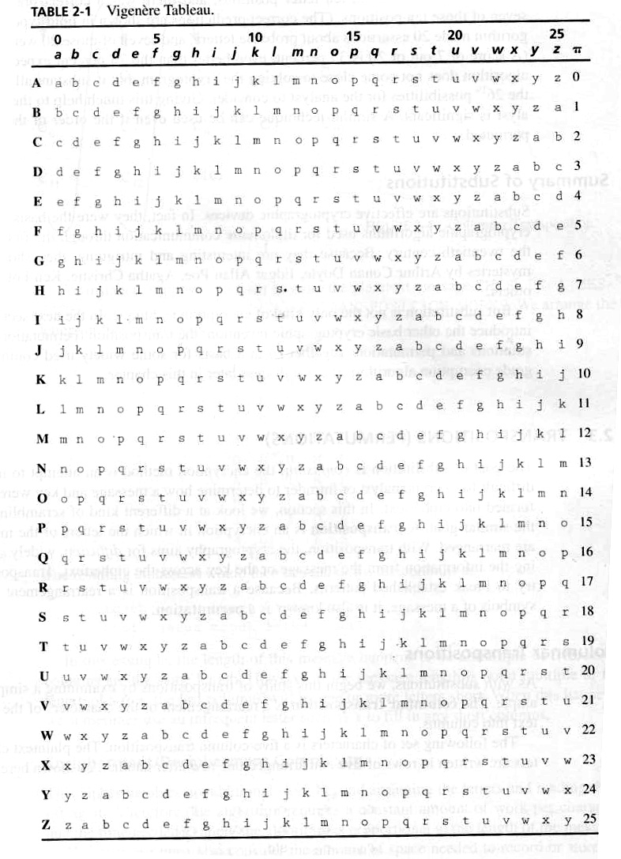
The Vigenere Tableau
The Vigenere Cipher , proposed by Blaise de Vigenere from the court of Henry III of France in the sixteenth century.

Slide 4
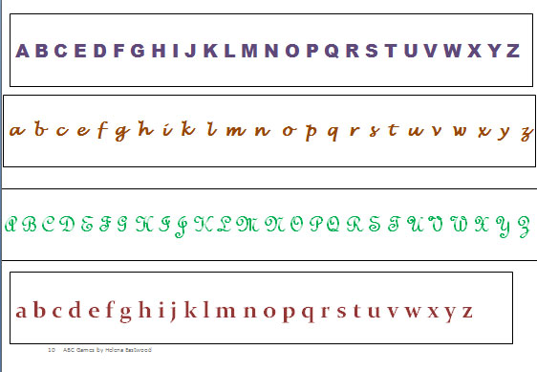
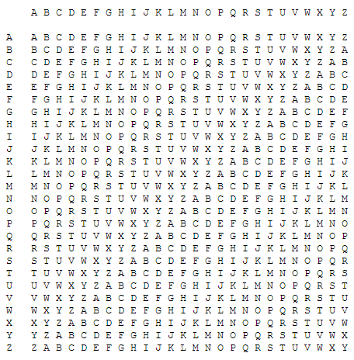

0 | 1 | 2 | 3 | 4 | 5 | 6 | 7 | 8 | 9 | 10 | 11 | 12 | 13 | 14 | 15 | 16 | 17 | 18 | 19 | 20 | 21 | 22 | 23 | 24 | 25

Slide 5
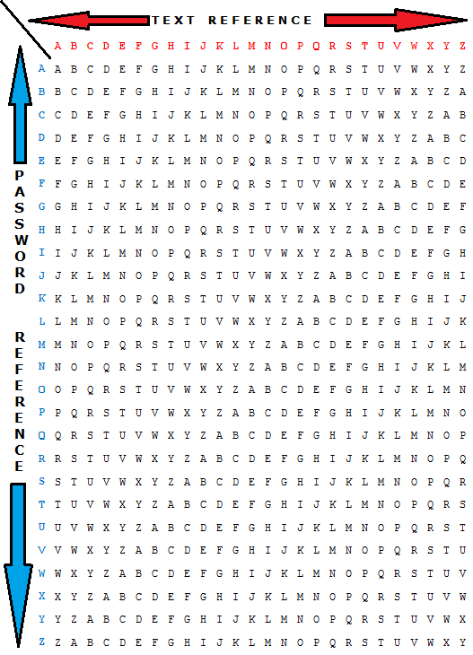

Slide 6
Example
Plaintext: Programmer
Keyword: code
Encrypted:

Slide 7
Consider the following:
  Plaintext: Programming is ME.
  Using Caesar Cipher where
  Shift: 13%3 – 2 + 2 ^2 . Find out the ciphertext.
  Using Substitution, what is the ciphertext:

Slide 8
Long Random Number Sequences
Vernam Cipher
A one-time Pad Cipher
Use Numbers Mod 26 to represent Letters
Use A two-digit Random Numbers
Add the two numbers and take Mod 26

Slide 9
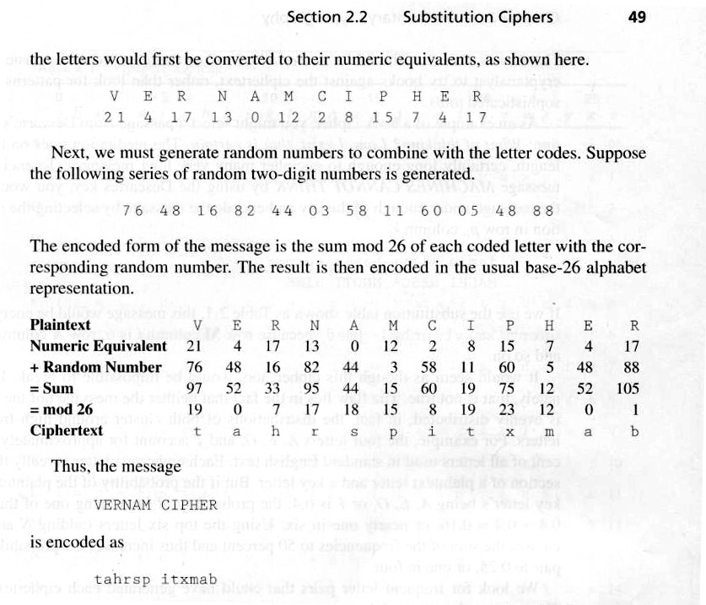
Vernam Cipher Example

